Slide 1

Diabetes Prediction using Machine Learning
SRM INSTITUTE OF SCIENCE AND TECHNOLOGY
18CSE392T : MACHINE LEARNING - I

Slide 2
Meet the Team
RA2111027010002
RA2111027010049
RA2111027010065
Chintapalli Dinesh
Snehal Sukundari
Ratan Priya
Singh

Slide 3
TABLE OF CONTENTS
01
02
03
04
Introduction
Motivation
Problem Formulation
Literature Review
05
References
06
Data Set
Algorithm
07
08
09
10
Visualization
Result
Conclusion

Slide 4

INTRODUCTION
Diabetes prediction involves using historical patient data to develop models that can forecast the likelihood of an individual developing diabetes in the future.
Early prediction of diabetes can lead to timely interventions, lifestyle adjustments, and personalized medical care, which are crucial for managing the disease effectively.
There are two main types of diabetes:
Type 1: Diagnosed in childhood
Type 2: Diagnosed in adulthood

Slide 5
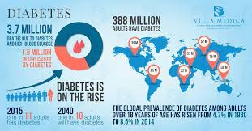
MOTIVATION
Predicting diabetes is a crucial area of research because early detection can lead to better management and improved quality of life for individuals at risk.
By developing accurate prediction models, we can empower both patients and healthcare professionals to take proactive measures and make informed decisions to prevent or manage diabetes effectively.
According to the World health Organization there were around 70 million people found diabetic in India in 2015.
As of September 2021, it was estimated that over 463 million adults (20-79 years) were living with diabetes worldwide.
The world health Organization also believes that diabetes will be the 7th leading cause of death by 2030.

Slide 6

PROBLEM FORMULATION
To Develop a machine learning model that predicts the likelihood of an individual developing diabetes based on a set of clinical and lifestyle attributes.
The goal is to create an accurate and interpretable predictive tool that aids healthcare professionals in identifying individuals at risk of diabetes and providing timely interventions.

Slide 7
LITERATURE REVIEW
S. No. | Title of the Work/Authors | Techniques | Results/Limitations
1. | Tao et al.[2] | KNN, Naïve Bayes, Decision Tree, Random Forest, SVM and Logistic Regression | Concentrated on the accuracy of recall and got better result. Filtering criteria can be improved
2. | Loannis et al..[1] | Naïve Bayes, Logistic regression, and Svm | From the three algorithm Svm provided high accuracy of 84%
3. | Weifeng Xu et al.[3] | ID3Naïv Bayes, Randomforest, Adaboost | Random forest classifier method better relative to other in contrast ID3 provided the least accuracy than others.

Slide 8
LITERATURE REVIEW
S. No. | Title of the Work/Authors | Techniques | Results/Limitations
4. | Yunsheng et al. [4] | DISKR and KNN | Accuracy increase can be increase by removing outliers. Space complexity decreased.
5. | Messan et al.[5] | GMM, ELM, ANN LR, and SVM | Comparison of algorithm were done from those method artificial neural network provide better accuracy than other classifier.
6. | Ramiro et al.[6] | Fuzzy rule | Wrong treatment was reduced using fuzzy rule and recommendation system was developed for doctor.

Slide 9
LITERATURE REVIEW
S. No. | Title of the Work/Authors | Techniques | Results/Limitations
7. | Swarupa et al.[7] | KNN,J48, ANN, zeroR, NB, evparameter selection, Filtered classifier and simple cart | Various dataset applied containing diabetes dataset. Cross validation not applied. NBshown high accuracy by providing accuracy of 77,01%.
8. | Pradeep & Dr.Naveen [8] | Decision tree(J48) | J48 is noted as good accuracy provider algorithm. Feature selection has high role in the prediction area.
9. | Sajida et al.[9] | Adaboost, j48,and Bagging | Adaboost was shown improved accuracy than other method.

Slide 10

SVM has the highest accuracy(84%) when compared to algorithms Naïve Bayes & Logistic regression.
INFRENCE FROM LITERATURE REVIEW
SVM works comparably well when there is an understandable margin of dissociation between classes for Diabetic and Non Diabetic.
SVMs are effective in handling high-dimensional data.
SVMs can be regularized, which means that the algorithm can be modified to avoid overfitting.

Slide 11
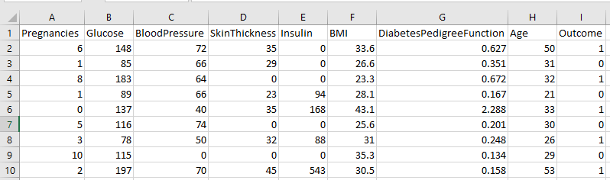
DATA SET
FEATURES/ATRRIBUTES :
1.Pregancies 6.BMI
2.Glucose 7. Diabetes Pedigree Function
3.Blood Pressure 8.Age
4. Skin Thickness 9.Outcome
5. Insulin
Number of row: 769
Number of column: 09
.

Slide 12
ALGORITHM
Algorithm : Support Vector Machine
Diabetes prediction often involves complex, non-linear relationships between various factors like glucose levels, BMI, family history, etc. SVMs can model these non-linear relationships effectively using kernel functions.
Medical datasets used for diabetic prediction can be high-dimensional due to the numerous factors taken into account. SVMs perform well in high-dimensional spaces
The classes (diabetic and non-diabetic) might be imbalanced, i.e., one class might have significantly fewer instances. SVMs can handle class imbalance well, ensuring that both classes are treated with equal importance

Slide 13
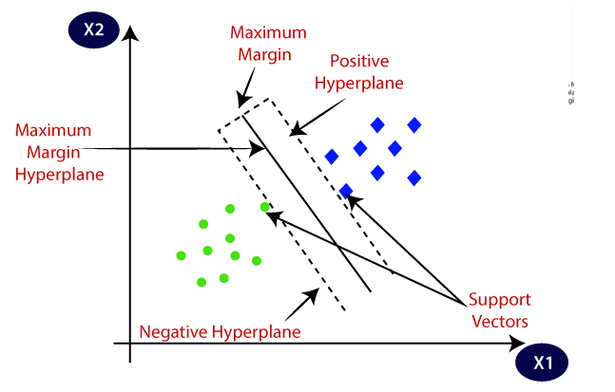
ALGORITHM
Algorithm : Support Vector Machine
People who are diabetic
People who are non-diabetic

Slide 14

WHY SVM
For predicting blood pressure status, they used conditional decision making and for predicting diabetes, they used SVM, KNN, and decision tree. Among these models, SVM worked better as they got 75% accuracy which is better than other classifier algorithms.
Maximizes the distance from the nearest data points.
They can be used to avoid the difficulties of using linear functions in the high-dimensional feature space.
Robustness to overfitting.

Slide 15
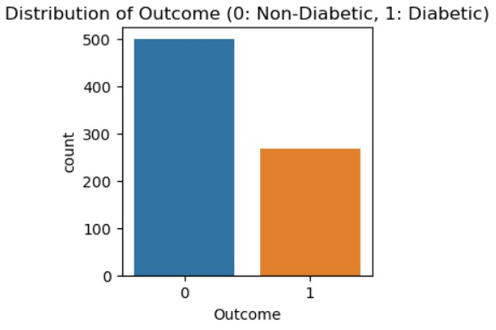
BAR GRAPH

Slide 16
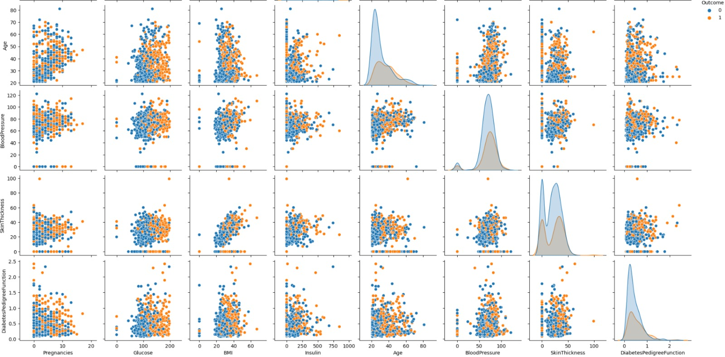
PAIR PLOT OF FEATURES

Slide 17
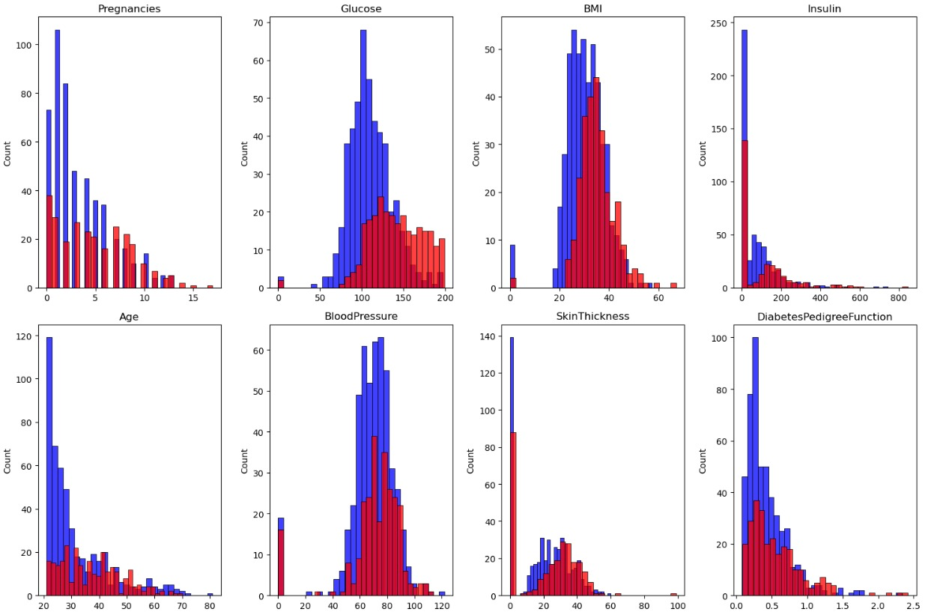
HISTOGRAM OF ATTRIBUTES

Slide 18
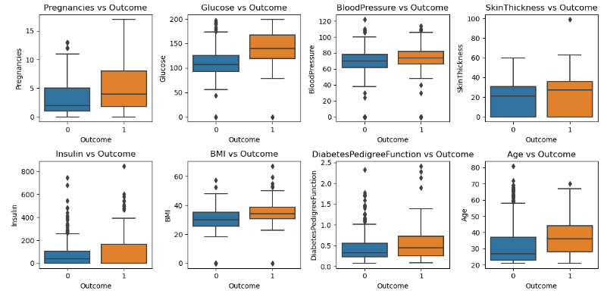
BOX PLOT

Slide 19
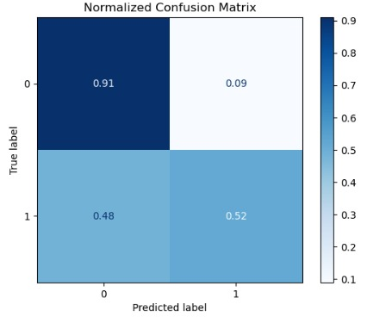
CONFUSION MATRIX

Slide 20
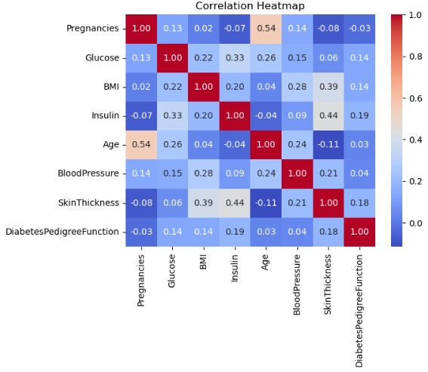
CORRELATION MATRIX

Slide 21
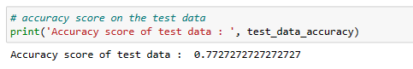
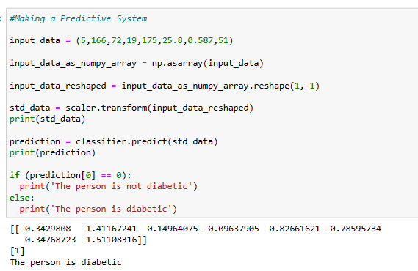
RESULT

Slide 22
CONCLUSION
In this project, we successfully developed a machine learning model for diabetes prediction using Python. We started by collecting and preprocessing a dataset containing various patient attributes, including age, BMI, and glucose levels, and the binary diabetes label.
This project demonstrates the effectiveness of machine learning in diabetes prediction. The model can be a valuable tool in helping to identify individuals at risk of diabetes, potentially leading to early interventions and improved patient outcomes.

Slide 23
REFRENCES
Gauri D. Kalyankar, Shivananda R. Poojara and Nagaraj V. Dharwadkar,” Predictive Analysis of Diabetic Patient Data Using Machine Learning and Hadoop”, International Conference.
B. Nithya and Dr. V. Ilango,” Predictive Analytics in Health Care Using Machine Learning Tools and Techniques”, International Conference on Intelligent Computing and Control Systems.
P. Suresh Kumar and S. Pranavi “Performance Analysis of Machine Learning Algorithms on Diabetes Dataset using Big Data Analytics”, International Conference on Infocom Technologies and Unmanned Systems, 978-1-5386-0514-1, Dec. 18-20, 2017.
Tejas N. Joshi, Prof. Pramila M. Chawan, "Diabetes Prediction Using Machine Learning Techniques". Int. Journal of Engineering Research and Application, Vol. 8, Issue 1, (Part -II) January 2018.

Slide 24




